Slide 1
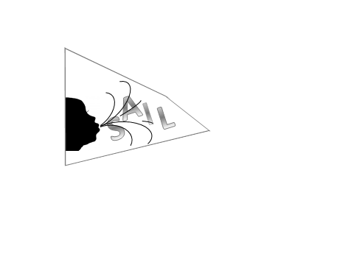

Sustained Aeration for Infant Lung
H.Kirpalani, M.Keszler, P.Davis, S.Ratcliffe
E.Foglia, A.Ades, M.Posencheg, K.Dysart, A. Chaudhary, S.Abbassi, T.Mancini, V. Nadkarni
A.Te Pas, Helmut Hummler, GL Lista, A.von Kaam
14 site international trial.

Slide 2
OUTLINE
    Establishing Lung Volume
        The fluid filled lung
        The Sustained Inflation (SI)
        Why we need to be ‘gentle’
        Current approach CPAP
        Key prior studies SI
    The SAIL Study
        Trial Details
        Who is involved?
        What do we ask of you?

Slide 3
Establishing Lung Volume
    What are the physiological issues to overcome?
    “the shadow of the valley of birth”
    Clement Smith: AmJDisChild 1951
    fluid filled lung to air filled
    collapsing chest wall

Slide 4
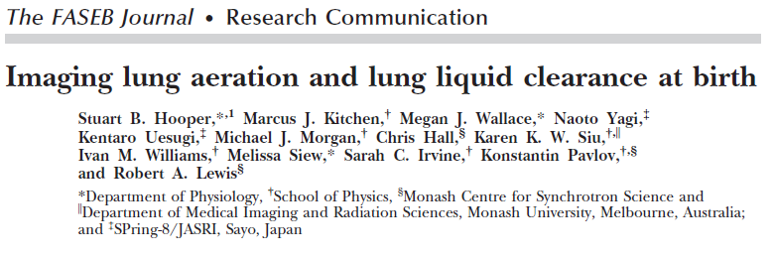
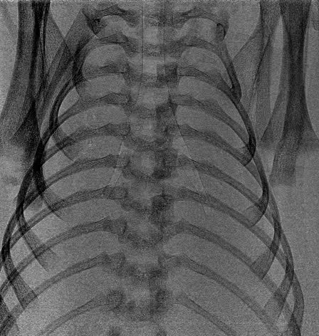
2007
http://www.fasebj.org/content/21/12/3329/suppl/DC1

Slide 5
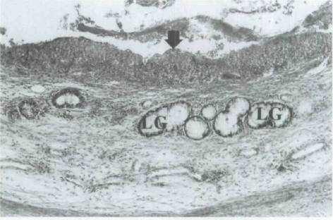
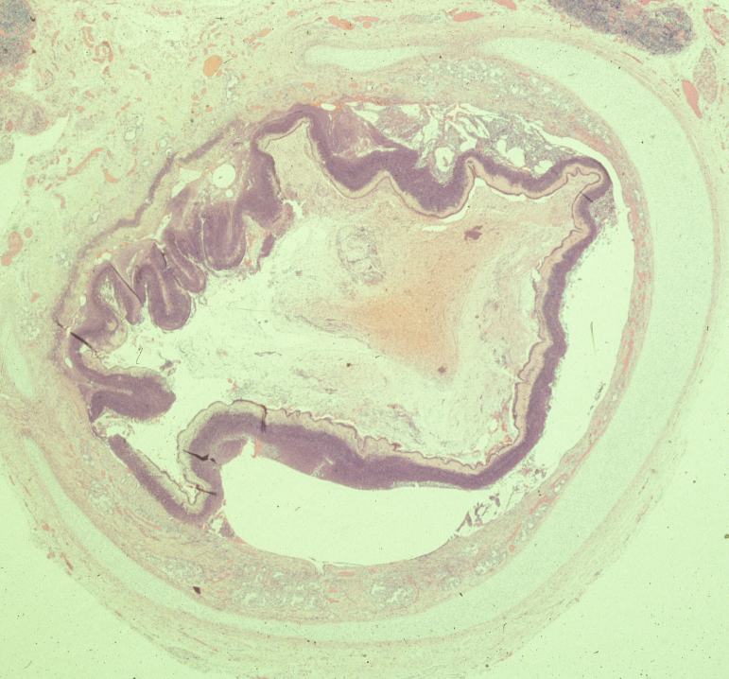
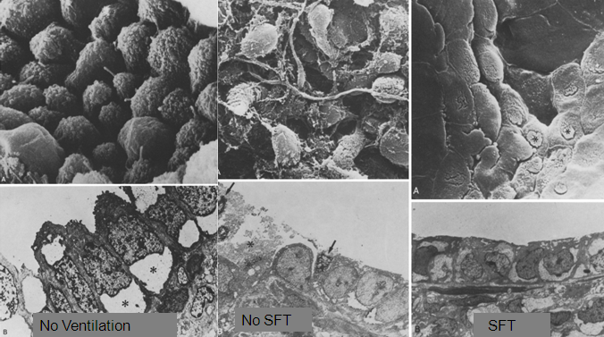
Sato K Ann Otol Rhinol Laryngol. 2006 115:816
Necrotizing TracheoBronchitis Kirpalani H CCM1985
Grossmann G, Eur J Pediatr 1986 145:361
Reyburn M. Am J Respir Crit Care Med. 2008
Control
Ventilation no SFT
Ventilation + SFT

Slide 6
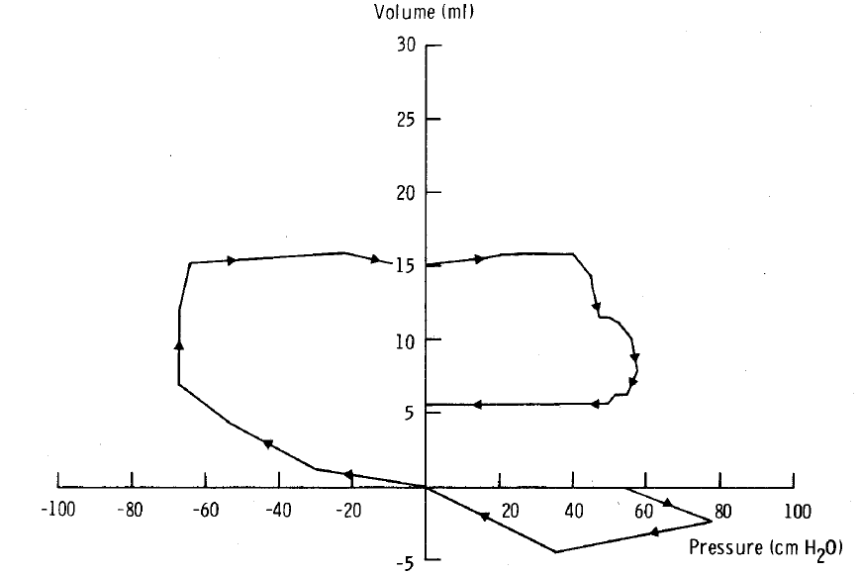
First Spontaneous Breath
First excursion is expiratory
Wide range of Opening Pressures, sometimes up to 90 cm H2O
Milner AD, Vyas H. Lung expansion at birth
J Pediatr. 1982;101:879-86.

Slide 7
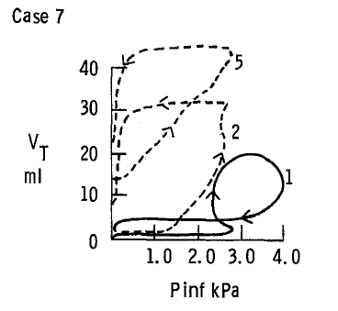
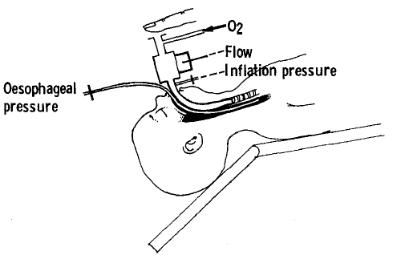
Boon AW, Milner AD, Hopkin IE: J Pediatrics 1979; 95: 1031
Using ‘Fast Rate’ Ventilation It 1 sec
Opening pressures initially high but become lower
FRC forms usually only during infant’s own respirations
1kPa=10 cm H20

Slide 8
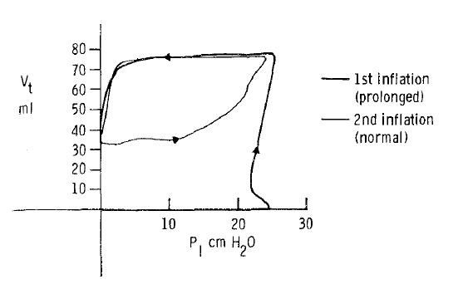
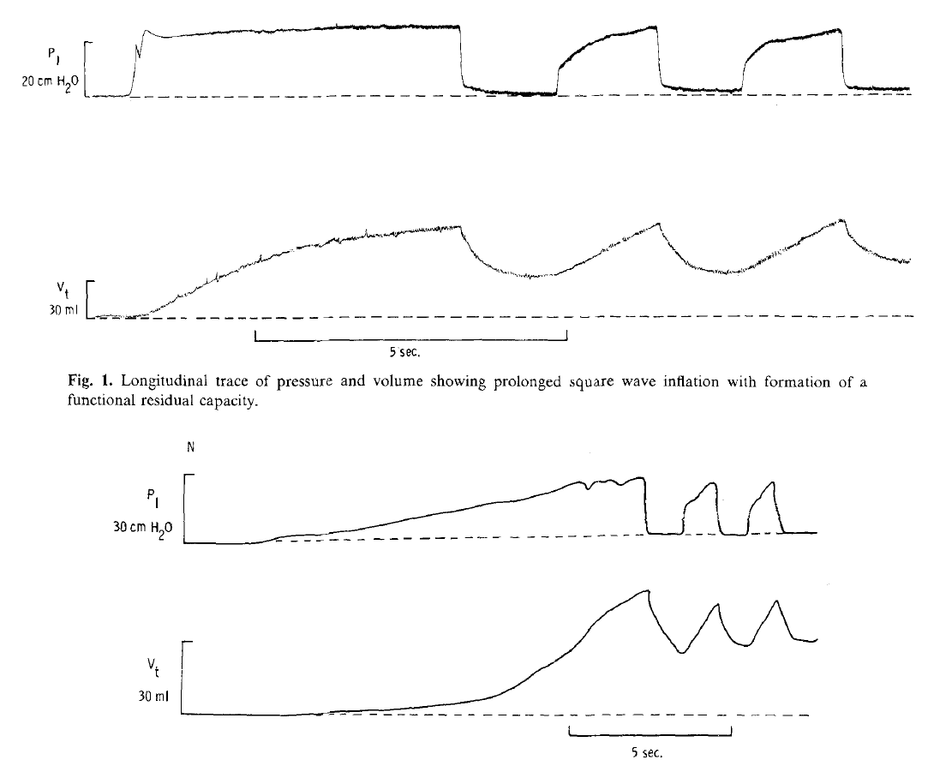
Vyas H, Milner AD, Hopkin IE Boon AW J Pediatrics 1981: 99: 635
Using ‘Slow Rate’ Ventilation
(It 5 seconds)
FRC formed quickly: Either:
Square wave
or
Slow rise to 30 cm H20

Slide 9
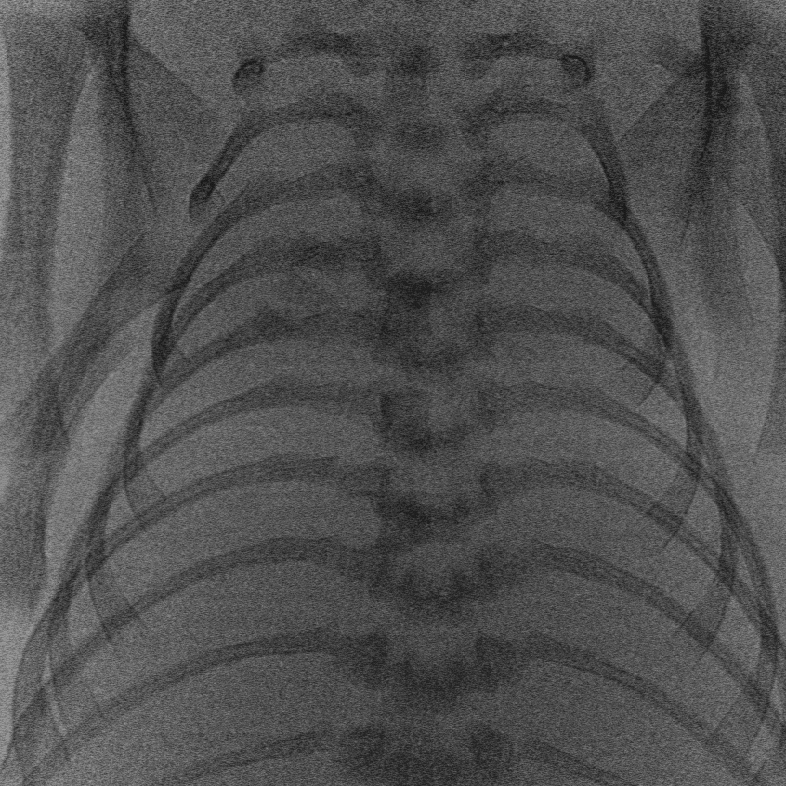
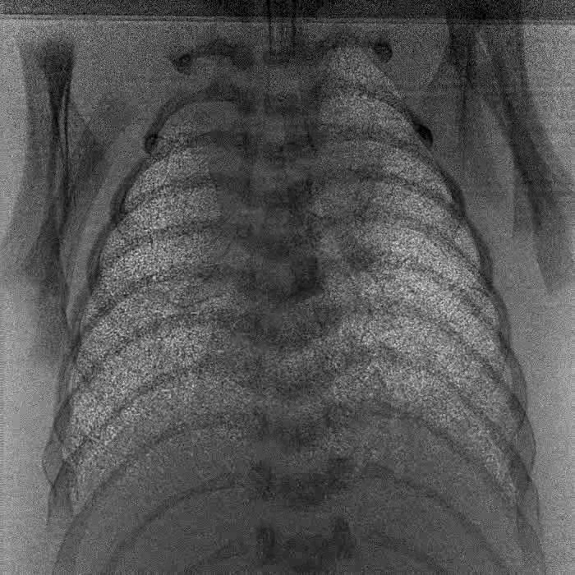
te Pas AB, Siew M, Wallace MJ, Kitchen MJ, Fouras A, Lewis RA, Yagi N, Uesugi K, Donath S, Davis PG, Morley CJ, Hooper SB. Establishing functional residual capacity at birth: the effect of sustained inflation and positive end-expiratory pressure in a preterm rabbit model. Pediatr Res. 2009;65(5):537-41
With PEEP alone – No SI
With PEEP and with SI

Slide 10
OUTLINE
    Establishing Lung Volume
        Physiology
        Why we need to be ‘gentle’
        What RCT data is there? CPAP vs Intubated IMV SI manouevres vs none

Slide 11
  Treatment of RDS – CPAP Gregory GA: N Engl J Med. 1971; 284:1333

Slide 12
P: In infants VLBW or ELBW in DR
I: does randomization to nCPAP
C: compared to intubation IMV
O: increase survival without BPD T: at 36 weeks PMA?
PICOT CPAP

Slide 13
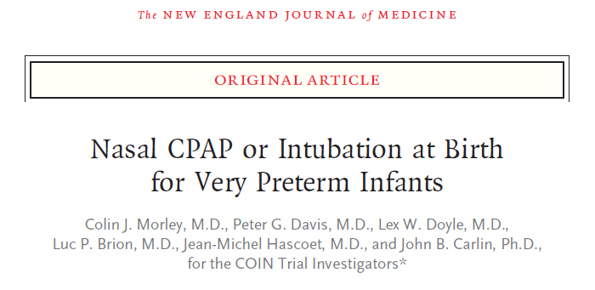
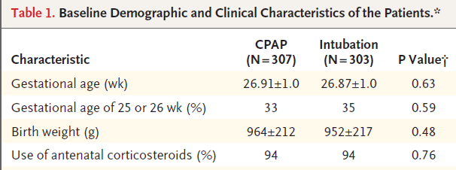
N Engl J Med 2008;358:700

Slide 14
Study population 25-28 weeks GA
CPAP
Intubation
N 307 303
OUTCOME (%) OR or p
Death or O2 36 w 33.9 38.9 0.8 (0.58 - 1.12)
Death before 36 w 6.5 5.9 1.10 (0.57-2.12)
Survivors on O2 29.3 35.1 0.76 (0.54-1.09)
Pthx 9.1 3.0 p=0.001
Gde 3-4 IVH 8.9 9.3 p=0.89
PVL 2.9 4.0 p=0.51
    NCPAP or Intubation at birth for very preterm Morley CJ NEJM:2008:358:700

Slide 15
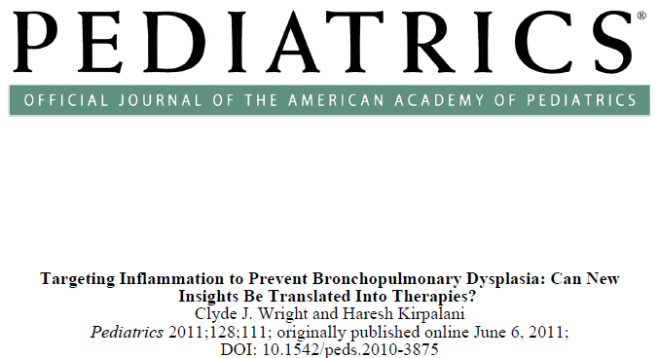
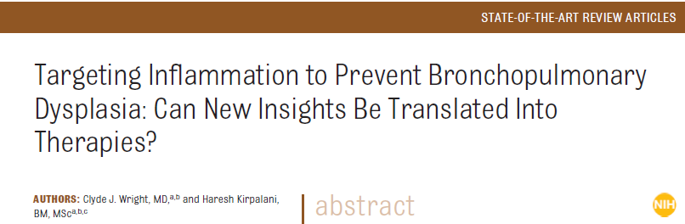
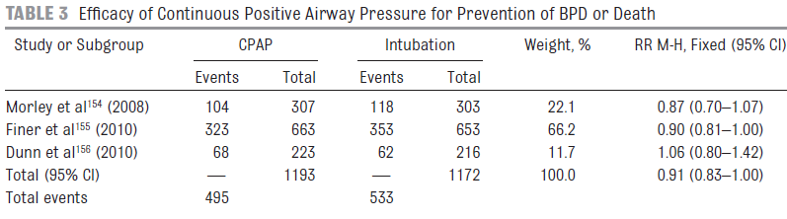
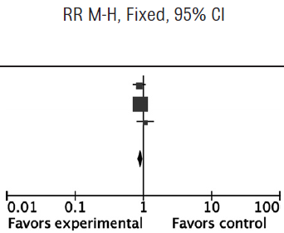
Wright CL, Kirpalani H 2011: 128: 111
0.91 (0.83, 1.00)

Slide 16
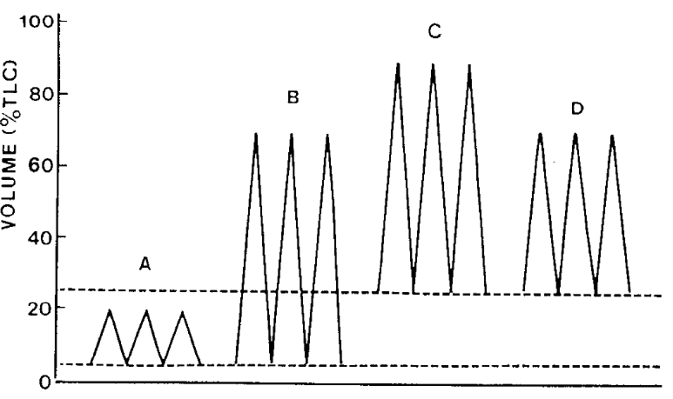
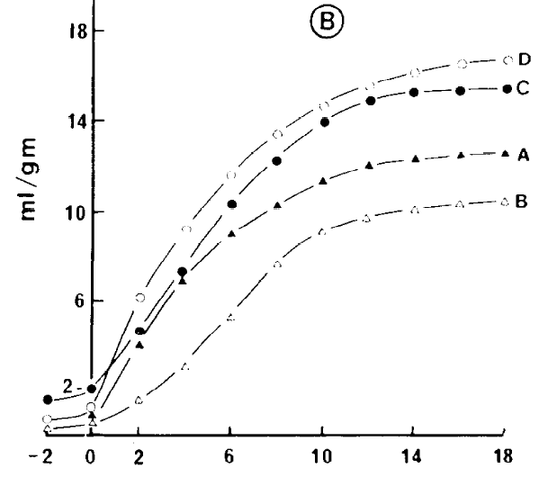
Wyszogrodski I, Kyei-Aboagye K, Taeusch HW Jr, Avery ME.
Surfactant inactivation by hyperventilation: conservation by end-expiratory pressure. J Appl Physiol. 1975 38:461

Slide 17
Surfactant use in DR trials
 | CPAP | Intubation
Coin | 38% | 77%
SUPPORT Finer N NICHD | 67.1% | 98.9%
Dunn M Vermont Oxford | 14.8% | 98.6%

Slide 18
Population: BW <1000 Intervention: Sustained Inflation + nCPAP
Comparison: standard resuscitation
Outcomes: survival No BPD Time frame: 36 weeks PMA
PICOT Sustained Inflation

Slide 19
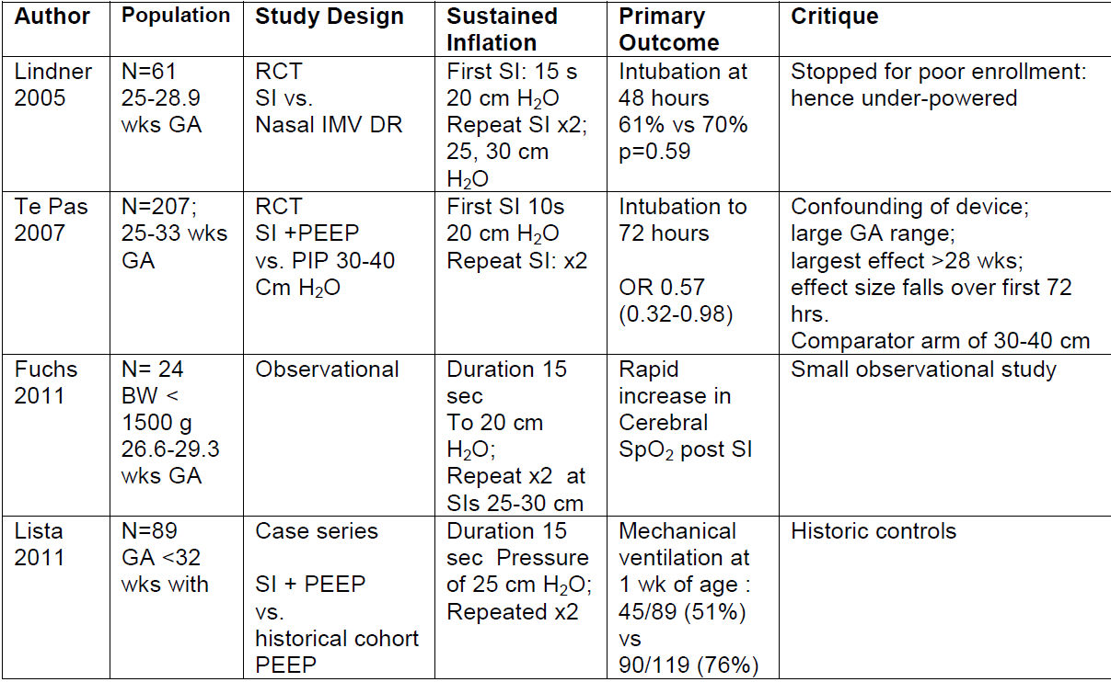

Slide 20
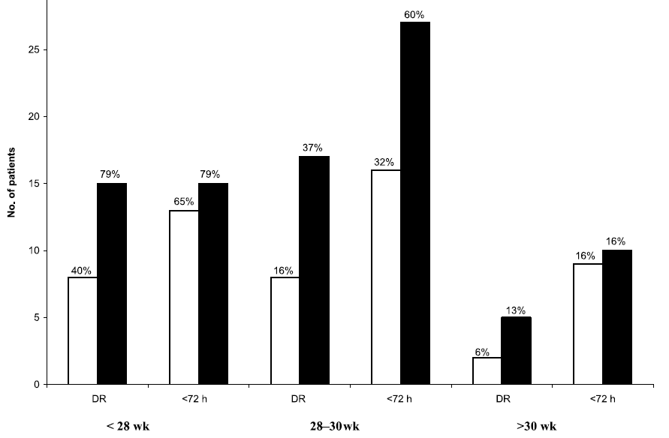
Te Pas, A: RCT of DR Respiratory Management Pediatrics 2007; 120: 3222
Experimental Maneuver | Retractions, poor respirations or distress T-piece + NP-Tube for 10s at SI 20-25 cm H₂0 x2 followed by early nCPAP 5-8 cm H₂0; Intubate HR<100 bpm | N= 104
Control Maneuver | Self-Inflating Bag: 30-20 cm H₂0 | N=103
1’ Outcome 72 hour intubated
Attenuation by 72 hours

Slide 21
Risks of air-leak in RCTs where two groups can be compared
Study | Rates of pneumothorax in control group using standard NRP | Rates of pneumothorax in Sustained inflation group | P values reported
Lindner 2005 | 4/30 (13%) | 3/31 (10%) | Ns
Te-Pas 2005 | 7/103 (7%) | 1/104 (1%) | 0.069
Lista Unpublished 2014 SPR | 2/124 | 8/126 ALL AFTER 48 hours of life None in DR | 0.102

Slide 22
Safety reporting requirements
Serious Adverse Event definitions: | Time Frame
Death | Within the first 48 hours post delivery
Pneumothorax, pulmonary interstitial emphysema (PIE) and pneumopericardium. Plus data on: a) any chest tube post DR b) need for new chest tube in NICU | Radiographic evidence within the first 10 days of life
Grade 1,2, 3 or 4 IVH | Head ultrasound findings with the first 10 days of life (report based only)
Adverse Event definitions: | Time Frame
Oxygen requirement of Fi02 ≥ 40% for 2 hours or more | Within the first 48 hours post delivery
BPD – defined as abnormal chest X-ray with infant requiring > 30% Oxygen or mechanical support | Radiographic evidence within the first month of life

Slide 23
SITES
Investigator | Site ID # | Clinical Center | Location
Haresh Kirpalani + others | 11 | Hospital of the University of Pennsylvania | Philadelphia, PA
Soraya Abbasi, MD | 12 | Pennsylvania Hospital | Philadelphia, PA
Martin Keszler, MD | 13 | Women & Infants Hospital of Rhode Island | Providence, RI
Robin Steinhorn, MD | 14 | University of California, Davis | Davis, CA
Anup C. Katheria, MD | 15 | Sharp Mary Birch Hospital for Women & Newborns | San Diego, CA
Steve M. Donn, MD | 16 | University of Michigan | Ann Arbor, MI
John Zupancic, MD, ScD | 17 | Beth Israel Deaconess Medical School | Boston, MA
Jonathan Davis, MD | 18 | Tufts University | Boston, MA
Peter Davis, MD, FRAXP | 51 | Royal Women’s Hospital | Melbourne, Australia
Arjan te_Pas, MD | 52 | Leiden University Medical Center | Leiden, Netherlands
Helmut Hummler, MD | 53 | Children’s Hospital, University of Ulm | Ulm, Germany
GianLuca Lista, MD | 54 | Ospedale dei Bambini | Milan, Italy
Georg Schmolzer, MD, PhD | 55 | Royal Alexandra Hospital | Edmonton, Canada
Ya'cov Rabi, MD | 56 | Foothills Hospital | Calgary, Canada

Slide 25
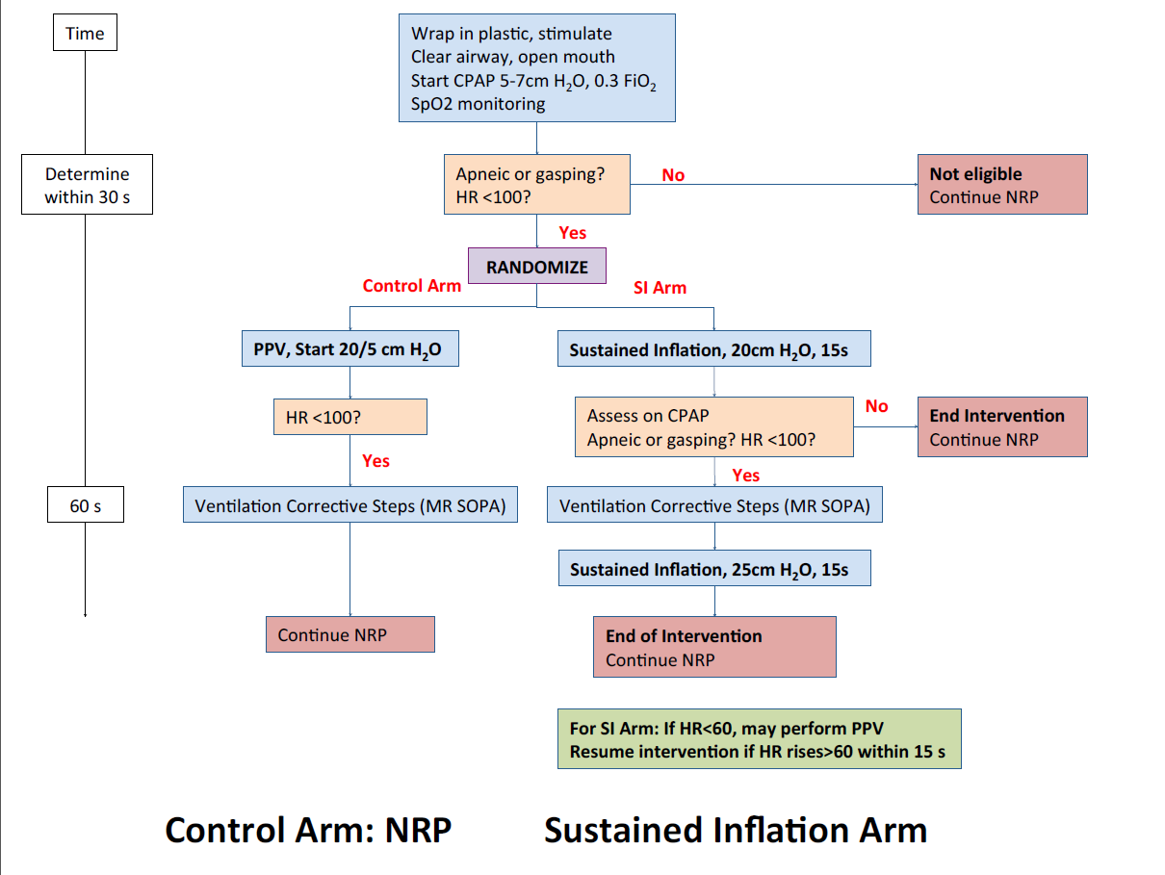

Slide 26
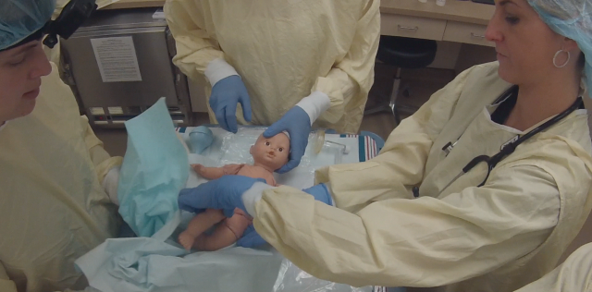

Training Video

Slide 27
SAIL Study Training
Initial Orientation
Simulation Sessions
Weekly Refresher for on-service teams
Just in time training for anticipated deliveries
  Protocol review
  Study videos
  Huddle

Slide 28
Key Roles in the Delivery Room
Role | Performed by | Responsibilities
Team Leader | Attending or Fellow | -Final determination of study eligibility and direct RT to open the envelope -Responsible for ensuring adherence to study algorithm
Study Coach (if personnel available) | FLC, Fellow, or RN | -Assists leader for algorithm adherence -Uses stopwatch to ensure appropriate time intervals are used, counts down these intervals aloud for the team -Anticipates and announces next step of algorithm
Airway provider | Fellow or FLC | -Clears airway and manages the facemask -Assesses breathing pattern
CV Assessor | Pediatric resident or FLC | -Stimulates infant and wraps in plastic -Performs clinical HR assessment -Helps occlude Neopuff
Respiratory therapist | RT | -Opens randomization envelope and announces allocation -Sets and adjusts Neopuff, titrates O2
Bedside nurse | RN | -Stimulates infant, wrap in plastic -Applies leads -Assists with clinical assessment of HR, breathing pattern
Recorder | RN | -Real time recording of HR, respiratory effort, interventions every 30 seconds for the first 2 minutes -Thereafter records per unit protocol

Slide 29

SAIL Logistics
Neo Attending/Fellow is contacted for an OB/MFM consult
Neo Attending/Fellow alerts the SAIL study staff for all consults for potential deliveries (22-26/7 wks GA) via text/phone/email
SAIL study staff will approach parents
If delivery is imminent and there is no time to consent
  Standard of care, NRP guidelines
Consent is granted or declined:
  SAIL study staff will alert OB/MFM via email
  Update the SAIL Roster in the locked Fellows Office (Ravdin 8)
  Update the SAIL Roster in the locked Clinical Specialist Office (ICN)

Slide 30
SAIL Logistics continued
If the delivery occurs within the window (< 26 6/7 wks GA)
  Prepare team for SAIL (assessment eligibility potential randomization)
    Huddle - may include 1-2 minute video refresher
    Assign roles:
    Multiples
      if both twins or all 3 triplets meet eligibility: randomized as single unit by RT staff (stratified by GA – different color envelopes)
      If any of multiples does not meet eligibility, (ie successfully breathing on CPAP at the 30 seconds of life) – infant is not included. Other qualifying twin-triplets randomized single unit
If delivery outside of window (> 27 0/7 wks GA)
  Infant is ineligible, continue with standard of care, NRP
If mother is discharged and re-admitted within window (26 6/7 wks GA)
  SAIL study staff will reaffirm mother’s approval for study intervention (time permitting)

Slide 31
SAIL Study Parent logs and Team Roster
SAIL Roster contains personal health information. This roster will need to be kept in a locked office to protect identity of the mothers.
The SAIL Roster will contain the following information:
Name of Mother
Date of admission
Date of Neo consult
GA at time of consult
SAIL consent outcome (consent obtained or declined)
27 0/7 wks GA date – out of eligibility window
SAIL Study Staff Contact List:
Liz Foglia © 267-441-7144
Aasma Chaudhary © 215-917-2322
Haresh Kirpalani © 267-844-3233

Slide 32
Frequently asked questions: Operational
  Who opens the randomization envelope?
  At HUP: the RT or Neopuff operator
  How is time tracked?
    Recording nurse: overall time-keeper for resuscitation
    Additional countdown timer set for 15 second intervals
  Increasing the PIP for the second SI: this can only happen once the neopuff is occluded

Slide 33
Frequently asked questions: protocol
Are both inadequate respiratory effort AND HR<100 required for trial eligibility, or is either criteria sufficient?
What is inadequate/adequate respiratory effort?
  Inadequate effort: Apnea or gasping respirations
Do I have to wait 30 seconds before determining eligibility and randomizing?
  No: this should take no more than 30s but can take less than 30s
If baby initially adequate respiratory effort; but then becomes apneic-WOB high after randomization period, study window closed by 60 secs
  Not randomized

Slide 34
Frequently asked questions: PPV
If the baby’s heart rate is less than 60 at any point in the resuscitation, should I perform PPV?
  Between SI 1 and 2?
  After 2nd SI?
Do I have to perform PPV?
How long should I perform PPV?
If the HR does not improve >60 within 15 seconds, should I continue the algorithm?

